Slide 1
2015-2016 A Day in the life of a third grade student
A.B. Combs Leadership Magnet Elementary School

Slide 2
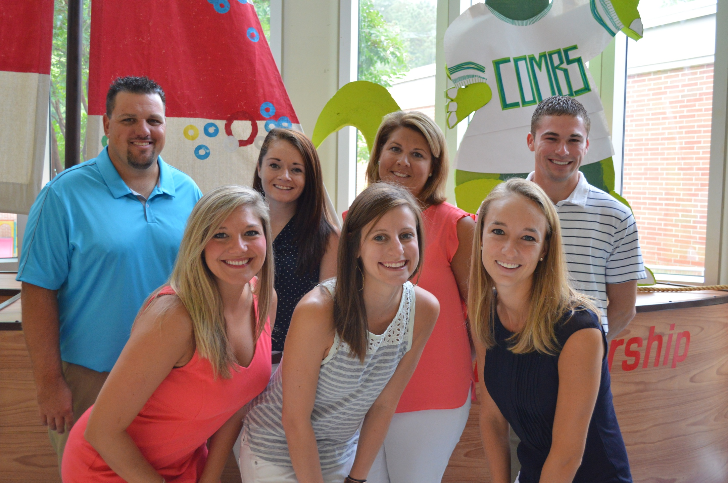
Third Grade Team
Ms. Coleman
Ms. Garrison
Ms. Levinson
Mrs. Pleasants
Mr. Lewis
Ms. Hughes
Mr. Weber

Slide 3
Pre-assessment!
What is your level of understanding of 3rd grade expectations and content?
A. I have no understanding
B. I have minimal understanding
C. I feel comfortable helping my child to have a successful year!
Notes:
emily

Slide 4
Our Mission…
Our Mission Statement
Our mission is to provide a foundation to inspire successful global leaders.
Strong, cohesive team
Collaborative planning
All teachers provide support for your child
Notes:
emily

Slide 5
Welcome to Third Grade
A few reminders:
Doors open at 8:00am and students are allowed to come into the classrooms.
Please sign and return agendas daily
Leadership Model
7 Habits
STEM Magnet School
Notes:
rick

Slide 6
3 Key Ideas for Parents about the Common Core
Thinking Deeply
Emphasizes critical thinking
analyze more, discuss more, evaluate more, justify more and explain their thinking & understanding deeply, especially in by written expression
Take-Away: Really thinking deeply is hard. Let it BE hard, help them talk it out.
Integrating Learning
Emphasizes learning across disciplines (reading with math & social studies standards combined into one task).
Students spend more time working together with different settings, structures & tools.
Take-Away: Problems & solutions happen every day in the real world.
Showing How They Know
Emphasizes proof & evidence.
Long gone are the days of worksheets, fact memorizations and skill & drill. Students are not taught this way and they are not assessed this way.
Take-away: The new tests will require students to explain how they know.
Notes:
Digging deeper; justify and prove their thinking—just knowing it isn’t enough emily

Slide 7
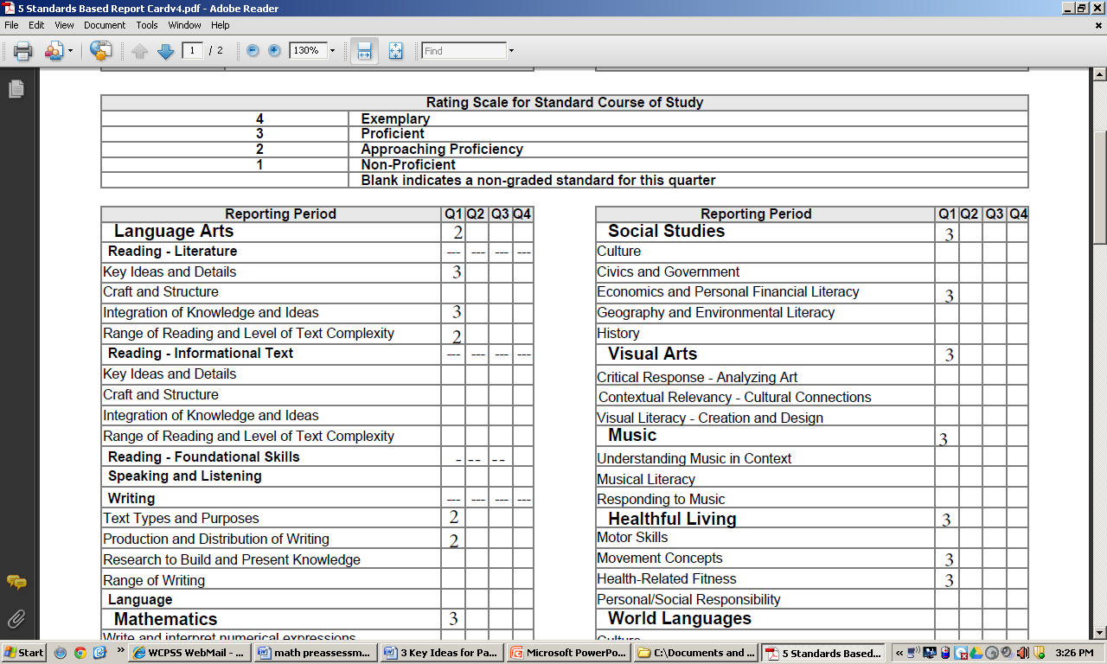
Here’s a 5th grade report card…
Notes:
cathy

Slide 8
Reading Workshop
Students are Reading to Learn…not as much Learning to Read in Third Grade
Balanced Literacy
Guided Reading Groups
Writing about Reading
Read-to-Self
Read Aloud
Time for Kids: Friendly Reminder $5
Assessments—it is not just about a reading level and written response
Notes:
kate

Slide 9
Key Concepts in 3rd Grade Reading
Let’s take a closer look at the standards we will cover this year with your students!
-Asking and answering questions
-Recount Fairytales and Fables
-Character Development
- Book Series
-Mysteries
-Non-fiction
-Biographies
-Testing as a genre

Slide 10
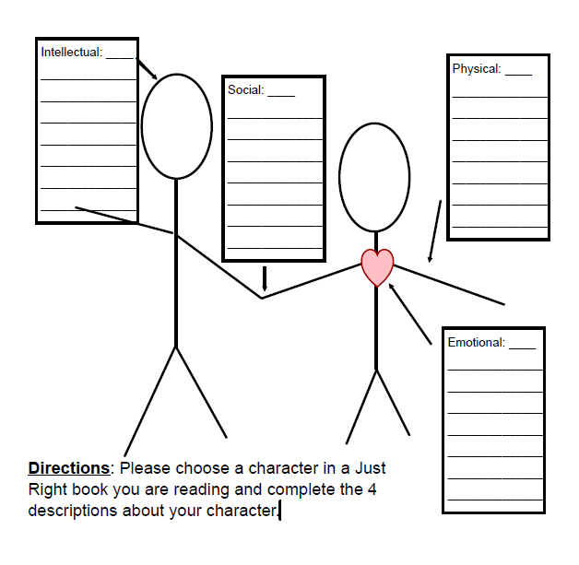
Score | Performance Assessment: RL3.3: Describe characters in a story (eg, their traits, motivations, or feelings) and explain how their actions contribute to the sequence of events.
4 | Response includes detailed explanations to all the following and includes text-to-text connections. What the character is thinking. What the character looks like. How the character feels. How the character interacts with those around him/her.
3 | Response includes brief explanations to all the following: What the character is thinking. What the character looks like. How the character feels. How the character interacts with those around him/her.
2 | Response includes only a few explanations of the following and/or very limited details: What the character is thinking. What the character looks like. How the character feels. How the character interacts with those around him/her.
1 | Response demonstrates a lack of understanding of characters.
Notes:
Kate

Slide 11
Reading Level Updates
For the past three years A.B. Combs has administered the mClass literacy assessment as a part of the formative assessment process in Wake County. These assessments are used by your child’s teacher to inform his or her instruction.
This year the mClass assessments have been re-normed. As a result, the rubric for the written component of the TRC assessment has been changed. This means that students may or may not score at the same level they scored at the end of last year. As these reports come home in the next several weeks, keep in mind that scores may have dropped. Your child’s teacher will discuss these scores with you during the first parent-teacher conference.

Slide 12
Writing Workshop
We will be writing a variety of texts this year…
Personal Narratives
Opinion pieces
Genre Studies (Mysteries, poems, letters, how-to’s, learning logs)
Informative & explanatory texts
Integrated into all curriculum areas throughout the year
Notes:
Catherine

Slide 13
Writing Workshop
I followed the writing process (plan, write, revise, edit & publish). (W3.5) | I wrote complete simple and compound sentences. (L3.1i) | I spelled sight words correctly and used spelling patterns. (L3.2f)
I used descriptive details. (W3.3b) | First Quarter Writing Expectations | I used transition words in my writing. (W3.3c)
My writing has a beginning, middle and end. a (W3.3d) | I used correct capitalization and punctuation. (L3.2f) | I used dialogue in my writing. (W3.3b)
Notes:
Catherine

Slide 14
Guided Math
Each day in math, we will have a…
Problem of the Day
Mini-lesson
Guided & Independent Practice
Spiral Review
You child will be tested on their math facts every week
Synergize to help your child
memorize their math facts
Notes:
Kayla

Slide 15
Key Concepts in 3rd Grade Math
Addition and Subtraction
Rounding
Geometry
Multiplication and Division
Area and Perimeter
Fractions

Slide 16
Math problem example
Notes:
kayla

Slide 17
Specials – 2 day rotation
Music with Mrs. Isadore
Art with Ms. Ferrell
PE with Coach Hook
Imagineering with Ms. Boughton
Chinese with Mrs. Liu
Library with Mrs. Headley
Specialty with Mrs. Sexton
Guidance with Ms. Conners (monthly)
Notes:
Polleck

Slide 18
A Note from our Specialists…
Art, Music and PE teachers grade students twice a year in the 2nd and 4th quarters.
We follow the North Carolina Standard Course of Study in our subjects and evaluate students based on those Essential Standards.
We see students two days in a row every 3 weeks, so it is important that your children are present at school or they may miss our entire rotation
Your child's class may be selected as part of the ASW (Analysis of Student Work) process. This would involve Art, Music and PE specialists collecting student work samples to be submitted anonymously for teacher evaluation purposes.

Slide 19
Science
Plant Growth & Soil
Life cycle of plants
Bees and Worms
Objects in the Sky
Integrates with Social Studies & Native Americans
Human Body
Skeletal, Muscular systems
States of Matter
Notes:
Levinson

Slide 20
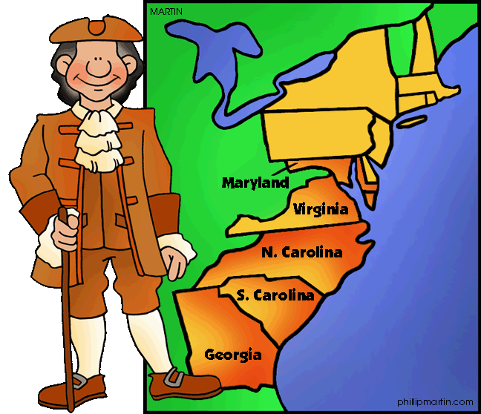
Social Studies
Civics & Government
Citizenship
Branches of Government
History & Colonial America
Native American
Colonial America
Colonial Days (lots of fun!)
Geography & Environment
Economics – Classroom Economy
http://13colonies.mrdonn.org/colonial_southern_states.gif
Notes:
Cathy

Slide 21
Field Trips
We will go on 3 field trips this year.
Old Salem Science Days (April 21)
NC State University math field trip
Marbles
VOLUNTEER CLEARANCE, do it now!
Must sign up on Wake County computer
Notes:
Catherine

Slide 22
EOG Testing
This is the year it begins!
It already began with The BOG
We are preparing students for it, and mentioning it casually.
Two days of testing in May
1 reading test
1 math test
Given two separate days
No retakes
Scores are reported in Summer 2016
Notes:
Polleck

Slide 23
Homework
30 minutes a night, Monday through Thursday
Reading & Writing (30 minutes)
Read & build stamina
Answer questions about text (in complete sentences).
Math (15 minutes)
Practice new skills we are learning in class
Spiral Review
Practice math facts—addition, subtraction, multiplication and division
Notes:
Kayla

Slide 24
Post-assessment!
What is your level of understanding of 3rd grade expectations and content?
A. I have no understanding
B. I have minimal understanding
C. I feel comfortable helping my child to have a successful year!
Notes:
emily

Slide 25
Issue Bin & Plus/Delta

Slide 26
Question & Answer

Slide 27
Thank you for coming!
Please meet us back in your child’s classroom for a few more details about the 3rd grade year!
Levinson: Ms. Levinson’s room
Garrison/Coleman: Ms. Garrison’s room
Weber/Hughes: Mr. Weber’s room
Pleasants/Lewis: Mr. Lewis’ room

